Slide 1
Host Security
Malicious Software

Slide 2
Viruses and Other Malicious Content
Computer viruses have got a lot of publicity
One of a family of malicious software
effects usually obvious
have figured in news reports, fiction, movies (often exaggerated)
getting more attention than deserve
are a concern though
Bernard Muwonge Ssajjabbi, PhD
MCN 7103: System and Network Security

Slide 3
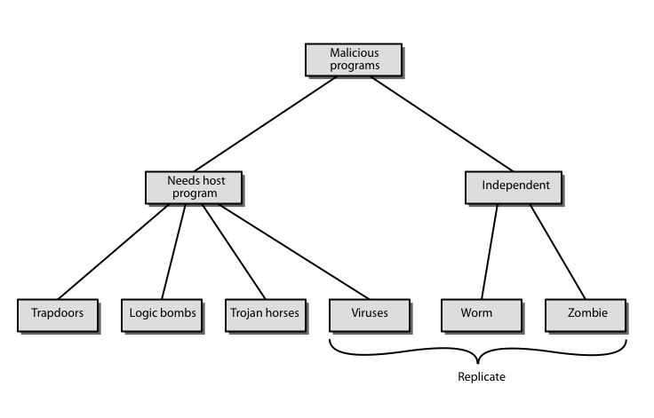
Malicious Software
Bernard Muwonge Ssajjabbi, PhD
MCN 7103: System and Network Security
Notes:
CS 543 - Data Warehousing (Sp 2005-2006) - Asim Karim @ LUMS

Slide 4
Backdoor or Trapdoor
Is a secret entry point into a program that allows someone that is aware of it to gain access without going through the usual security access procedures.
  A programmer may install a back door so that the program can be accessed for troubleshooting or other purposes.
  Used legitimately for many years to debug and test programs, but become a threat when left in production programs.
However, attackers often use back doors that they detect or install themselves, as part of an exploit.
Difficult implementing operatg sys ctrls for backdoors.
Security measures must focus on the program development and software update activities.
Bernard Muwonge Ssajjabbi, PhD
MCN 7103: System and Network Security

Slide 5
Logic bomb
One of oldest types of malicious software
Code embedded in legitimate program
Activated when specified conditions met
    eg presence/absence of some file
    particular date/time
    particular user running application.
when triggered typically damage system by altering, deleting files or cause machine halt
    modify/delete files/disks, halt machine, etc
Bernard Muwonge Ssajjabbi, PhD
MCN 7103: System and Network Security

Slide 6
Trojan Horse
Program with hidden code that when invoked performs unwanted side-effects
Usually superficially attractive
  E.g., game, s/w upgrade etc
When run performs some additional tasks
  allows attacker to indirectly gain access they do not have directly
Often used to propagate a virus/worm or install a backdoor
  Or simply to destroy data
Bernard Muwonge Ssajjabbi, PhD
MCN 7103: System and Network Security

Slide 7
Zombie
A program that secretly takes over other networked computer,
Uses that computer to launch attacks that are difficult to trace to the zombie’s creator.
Used to launch DDoS attacks; Planted on hundreds of computers belonging to unsuspecting third parties,
Then used to overwhelm target Web site by launching overwhelming onslaught of Internet traffic
Typically zombies exploit known flaws in networked computer systems.
Bernard Muwonge Ssajjabbi, PhD
MCN 7103: System and Network Security

Slide 8
Viruses
A piece of software that can “infect” other programs by modifying them;
Modification includes a copy of the virus program, which can then go on to infect other programs.
  It can be compared to biological viruses,
  Like them, a computer virus carries in its instructional code the recipe for making perfect copies of itself.
Once a virus is executing, it can perform any function, such as erasing files and programs.
Bernard Muwonge Ssajjabbi, PhD
MCN 7103: System and Network Security
Notes:
Discuss observed security trends (Stallings section 1.1 & Figure 1.2 above), noting growth in sophistication of attacks contrasting with decrease in skill & knowledge needed to mount an attack.

Slide 9
Virus Operation
During its lifetime, a typical virus goes through the following four phases:
  Dormant phase: virus is idle, waiting for trigger event (e.g date, program or file, disk capacity).
    Not all viruses have this stage
  Propagation phase: virus places a copy of itself into other programs / system areas
  Triggering phase: virus is activated by some trigger event to perform intended function
  Execution phase: desired function is performed
Most viruses work in a manner specific to a particular operating system or even hardware platform,
Are designed to take advantage of the details and weaknesses of particular systems.
Bernard Muwonge Ssajjabbi, PhD
MCN 7103: System and Network Security

Slide 10
Virus Structure
program V :=
{goto main;
1234567;
subroutine infect-executable := {loop:
file := get-random-executable-file;
if (first-line-of-file = 1234567) then goto loop
else prepend V to file; }
subroutine do-damage:= {whatever damage is to be done}
subroutine trigger-pulled := {return true if condition holds}
main: main-program := {infect-executable;
if trigger-pulled then do-damage;
goto next;}
next:
}
Bernard Muwonge Ssajjabbi, PhD
MCN 7103: System and Network Security
Notes:
Stallings Figure 19.1 shows a general depiction of virus structure. The virus code (V) is prepended to infected programs (assuming the entry point is the first line of the program). The first line of code jumps to the main virus program. The second line is a special marker for infected programs. The main virus program first seeks out uninfected executable files and infects them. Then it may perform some action, usually detrimental to the system, depending on some trigger. Finally, the virus transfers control to the original program. If the infection phase of the program is reasonably rapid, a user is unlikely to notice any difference between the execution of an infected and uninfected program. This type of virus can be detected because the length of the program changes. More sophisticated variants attempt to hide their presence better, by for example, compressing the original program.

Slide 11
The virus code (V) is prepended to infected programs (assuming the entry point is the first line of the program).
The first line of code jumps to the main virus program.
The second line is a special marker for infected programs.
The main virus program first seeks out uninfected executable files and infects them. Then it may perform some action, usually detrimental to the system, depending on some trigger.
Finally, the virus transfers control to the original program. If the infection phase of the program is reasonably rapid, a user is unlikely to notice any difference between the execution of an infected and uninfected program.
Bernard Muwonge Ssajjabbi, PhD
MCN 7103: System and Network Security

Slide 12
Types of Viruses
Can be classified on basis of how they attack
Parasitic virus:
  Attaches itself to executable files and replicates when the infected program is executed.
Memory-resident virus:
  Lodges in main memory as part of a resident system program, and infects every program that executes
Boot sector virus:
  Affects the boot sector of a floppy or hard disk.
Bernard Muwonge Ssajjabbi, PhD
MCN 7103: System and Network Security
Notes:
Expand on definition and use of “security attack”, as detailed above.
See Stallings Table 1.1 for definitions of threat and attack.

Slide 13
Stealth virus:
  A virus explicitly designed to hide itself from detection by antivirus software.
Polymorphic virus:
  Encrypt themselves in a different way (using different algorithms and encryption keys) every time they infect a system.
  This makes it impossible for anti-viruses to find them using string or signature searches (because they are different in each encryption)
  Also enables them to create a large number of copies of themselves.
Bernard Muwonge Ssajjabbi, PhD
MCN 7103: System and Network Security

Slide 14
  Metamorphic virus:
    Mutates with every infection, rewriting itself completely at each iteration changing behavior and/or appearance,
    Increases the difficulty of detection.
  Macro Virus
    Infect files that are created using certain applications or programs that contain macros.
    Macro code attached to some data file
    Interpreted by program using file
      eg Word/Excel macros
    Code is now platform independent
      Examples of macro viruses: Relax, Melissa.A, Bablas, O97M/Y2K.
Bernard Muwonge Ssajjabbi, PhD
MCN 7103: System and Network Security

Slide 15
E-mail Virus
Spread using email with attachment containing a macro virus
  cfr Melissa
Triggered when user opens attachment
or worse even when mail viewed by using scripting features in mail agent
Hence propagate very quickly
Usually targeted at Microsoft Outlook mail agent & Word/Excel documents
Need better O/S & application security
Bernard Muwonge Ssajjabbi, PhD
MCN 7103: System and Network Security

Slide 16
Worm
Replicating but not infecting program
Typically spreads over a network
  cf Morris Internet Worm in 1988
  led to creation of CERTs
Using users distributed privileges or by exploiting system vulnerabilities
Widely used by hackers to create zombie PC's, subsequently used for further attacks, esp DoS
Major issue is lack of security of permanently connected systems, esp PC's
continued
Bernard Muwonge Ssajjabbi, PhD
MCN 7103: System and Network Security

Slide 17
Worm operation
A network worm exhibits the same characteristics as a computer virus:
  a dormant phase,
  a propagation phase,
  a triggering phase, and
  an execution phase.
  The propagation phase generally:
    Searches for other systems to infect by examining host tables etc
    Establishes a connection with a remote system
    Copies itself to the remote system and cause the copy to be run.
Bernard Muwonge Ssajjabbi, PhD
MCN 7103: System and Network Security

Slide 18
Morris Worm
best known classic worm
released by Robert Morris in 1988
targeted Unix systems
using several propagation techniques
  simple password cracking of local pw file
  exploit bug in finger daemon
  exploit debug trapdoor in sendmail daemon
if any attack succeeds then replicated self
Bernard Muwonge Ssajjabbi, PhD
MCN 7103: System and Network Security

Slide 19
Some documented worm attacks
Code Red
  Exploited a security hole in Microsoft Internet Information Server (IIS) to penetrate and spread,
  Disabled the system file checker in Windows.
  It probed random IP addresses to spread to other hosts, &
  Had a trigger time for a DDoS attack.
  It infected nearly 360,000 servers in 14 hours, & consumed enormous amounts of Internet capacity, disrupting service.
Code Red 2 - Installed backdoor Code Red II
  A variant that installed a backdoor allowing a hacker to direct activities of victim computers.
Nimda
  appeared in late 2001 & spreads by multiple mechanisms:
    email, shares, web client, IIS, Code Red 2 backdoor.
  It modifies Web documents & certain executable files and creates numerous copies of itself under various filenames.
Bernard Muwonge Ssajjabbi, PhD
MCN 7103: System and Network Security

Slide 20
SQL Slammer worm
  Appeared in early 2003, exploiting a buffer overflow vulnerability in Microsoft SQL server.
  It was extremely compact and spread rapidly, infecting 90% of vulnerable hosts within 10 minutes.
Sobig.f worm
  Appeared in late 2003, exploiting open proxy servers to turn infected machines into spam engines.
  At its peak, it accounted for one in every 17 messages
  Produced more than 1m copies of itself within the first 24 hours.
Mydoom
  Appeared in 2004 & is a mass-mailing e-mail worm that installed a backdoor in infected computers.
  Replicated up to 1000 times per minute and reportedly flooded the Internet with 100 million infected messages in 36 hours.
continued
Bernard Muwonge Ssajjabbi, PhD
MCN 7103: System and Network Security

Slide 21
Worm Technology
The state of the art in worm technology includes:
  Multiplatform:
    not limited to Windows,
    can attack a variety of O/S’s, esp UNIX.
  Multiexploit:
    penetrate systems in a variety of ways
  Ultrafast spreading:
    using prior scan to get addresses of vulnerable machines
  Polymorphic:
    adopt virus polymorphic technique to evade detection
  Metamorphic:
    change both appearance & behavior patterns
  Transport vehicles:
    to spread other distributed attack tools, eg zombies
  Zero-day exploit:
    exploit unknown vulnerability
Bernard Muwonge Ssajjabbi, PhD
MCN 7103: System and Network Security

Slide 22
Virus Countermeasures
Best countermeasure is prevention
  But in general not possible
Hence need to do one or more of the following:
  Detection:
    determine that infection has occurred and locate the virus
  Identification:
    Identify specific virus that has infected a program
  Removal:
    Remove all virus traces from the infected program and restore it to its original state; or discard infected program and reload a clean backup version
Bernard Muwonge Ssajjabbi, PhD
MCN 7103: System and Network Security

Slide 23
Anti-Virus Software
First-generation
  scanner uses virus signature to identify virus
  or change in length of programs.
  Limitation: Only detects known viruses
Second-generation.
  Doesn’t rely on a specific signature
  uses heuristic rules to spot viral infection
  or uses crypto hash of program to spot changes
Third-generation
  memory-resident programs identify virus by actions
  Adv: it’s not necessary to develop signatures & heuristics for a wide array of viruses.
Fourth-generation
  packages with a variety of antivirus techniques
  E.g., scanning & activity traps, access-controls
arms race continues
Bernard Muwonge Ssajjabbi, PhD
MCN 7103: System and Network Security

Slide 24
Advanced Anti-Virus Techniques
generic decryption
  enables the antivirus program to easily detect even the most complex polymorphic viruses, while maintaining fast scanning speeds
  use CPU simulator to check program signature & behavior before actually running it
Digital Immune System (IBM)
  general purpose emulation & virus detection
  any virus entering org is captured, analyzed, detection/shielding created for it, removed
Bernard Muwonge Ssajjabbi, PhD
MCN 7103: System and Network Security

Slide 25
Digital Immune System
A monitoring program on each PC infers that a virus may be present, & forwards infected programs to an administrative machine.
2. The administrative machine encrypts the sample and sends it to a central virus analysis machine
3. This machine creates an environment in which the infected program can be safely run for analysis to produce a prescription for identifying and removing the virus
4. The resulting prescription is sent back to the administrative machine
5. The administrative machine forwards the prescription to the infected client
6. The prescription is also forwarded to other clients in the organization
7. Subscribers around the world receive regular antivirus updates that protect them from the new virus.
Bernard Muwonge Ssajjabbi, PhD
MCN 7103: System and Network Security

Slide 26
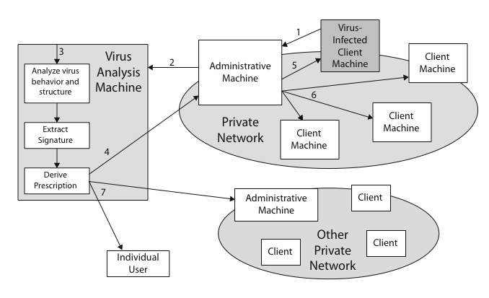
Digital Immune System
Bernard Muwonge Ssajjabbi, PhD
MCN 7103: System and Network Security
Notes:
Also have “active attacks” which attempt to alter system resources or affect their operation.
By modification of data stream to:
+ masquerade of one entity as some other
+ replay previous messages (as shown above in Stallings Figure 1.4b)
+ modify messages in transit
+ denial of service
Active attacks present the opposite characteristics of passive attacks. Whereas passive attacks are difficult to detect, measures are available to prevent their success. On the other hand, it is quite difficult to prevent active attacks absolutely, because of the wide variety of potential physical,software,and network vulnerabilities. Instead, the goal is to detect active attacks and to recover from any disruption or delays caused by them.

Slide 27
Behavior-blocking software
Integrates with the O/S of a host computer and monitors program behavior in real-time for malicious actions.
Blocks potentially malicious actions before they have a chance to affect the system. Monitored behaviors can include:
    Attempts to open, view, delete, and/or modify files
    Attempts to format disk drives and other unrecoverable disk operations
    Modifications to the logic of executable files or macros
    Modification of critical system settings, e.g., start-up settings
    Scripting of e-mail & instant messaging clients to send executable content
    Initiation of network communications.
Bernard Muwonge Ssajjabbi, PhD
MCN 7103: System and Network Security

Slide 28
Behavior-blocking software cont…
If the behavior blocker detects that a program is initiating would-be malicious behaviors as it runs, it can block these behaviors in real-time and/or terminate the offending software.
Advantageous over established antivirus detection techniques since it can intercept all suspicious requests, & can identify and block malicious actions regardless of how concealed the program logic appears to be.
But malicious code must run on the target machine before detection.
Bernard Muwonge Ssajjabbi, PhD
MCN 7103: System and Network Security

Slide 29
Distributed Denial of Service (DDoS) attacks
DDoS attacks form a significant security threat making networked systems unavailable by flooding with useless traffic
using large numbers of “zombies”
growing sophistication of attacks
defense technologies struggling to cope
Bernard Muwonge Ssajjabbi, PhD
MCN 7103: System and Network Security

Slide 30
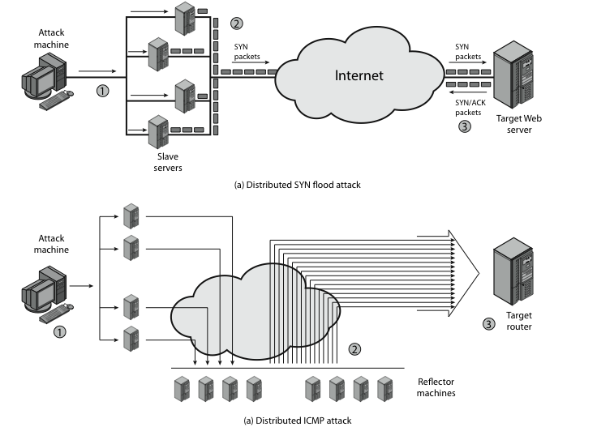
DDoS Attacks
continued
Bernard Muwonge Ssajjabbi, PhD
MCN 7103: System and Network Security

Slide 31
Constructing the DDoS Attack Network
The first step in a DDoS attack is for the attacker to infect a number of machines with zombie software that will be used to carry out the attack.
Requirements are:
  Software that can carry out the DDoS attack, runnable on a large number of machines, concealed, communicating with attacker or time-triggered, and can launch intended attack toward the target
  A vulnerability in a large number of systems, that many system admins/users have failed to patch; to help attacker install zombie s/w
  A strategy for locating vulnerable machines, known as scanning. Here the attacker seeks out vulnerable machines & infects them. The scanning continues til many are infected.
Bernard Muwonge Ssajjabbi, PhD
MCN 7103: System and Network Security

Slide 32
Types of strategies include:
    Random: Hosts probe random IP addresses in the IP address space.
    Hit-list: Attacker uses a long list of potential vulnerable machines
    Topological: use information on infected victim machine to find more hosts.
    Local subnet: Infected host looks for targets in own local network.
Bernard Muwonge Ssajjabbi, PhD
MCN 7103: System and Network Security

Slide 33
DDoS Countermeasures
Three lines of defense against DDoS attacks:
  Attack prevention and preemption (before the attack): to enable victim to endure attack attempts without denying service to legitimate clients
  Attack detection and filtering (during the attack): to attempt to detect attack as it begins and respond immediately, minimizing impact of attack on the target
  Attack source traceback and identification (during and after the attack): to identify source of attack to prevent future attacks.
The challenge in coping with DDoS attacks is the sheer number of ways in which they can operate, hence countermeasures must evolve with the threat.
Bernard Muwonge Ssajjabbi, PhD
MCN 7103: System and Network Security

Slide 34
References
Cryptography and Network Security: Principles and Practice, Third Edition, by William Stallings (2000)
Bernard Muwonge Ssajjabbi, PhD
MCN 7103: System and Network Security
Notes:
The second, illustrated in Figure 1.6, model is concerned with controlled access to information or resources on a computer system, in the presence of possible opponents. Here appropriate controls are needed on the access and within the system, to provide suitable security. Some cryptographic techniques are useful here also.

Slide 35

Q & A
“In life, always expect questions, but do not expect answers”
Bernard Muwonge Ssajjabbi, PhD
MCN 7103: System and Network Security

